Slide 1
Chapter 7
Manipulating the Camera

Slide 2
This Chapter
Make the camera easier to work with
Define default manipulation functionality
Interpolate values to support smooth transitions
Use of math in describing behaviors
Program with multiple views
Already know this
Transform between Canvas (Device) Coordinate to World Coordinate
Support mouse input

Slide 3
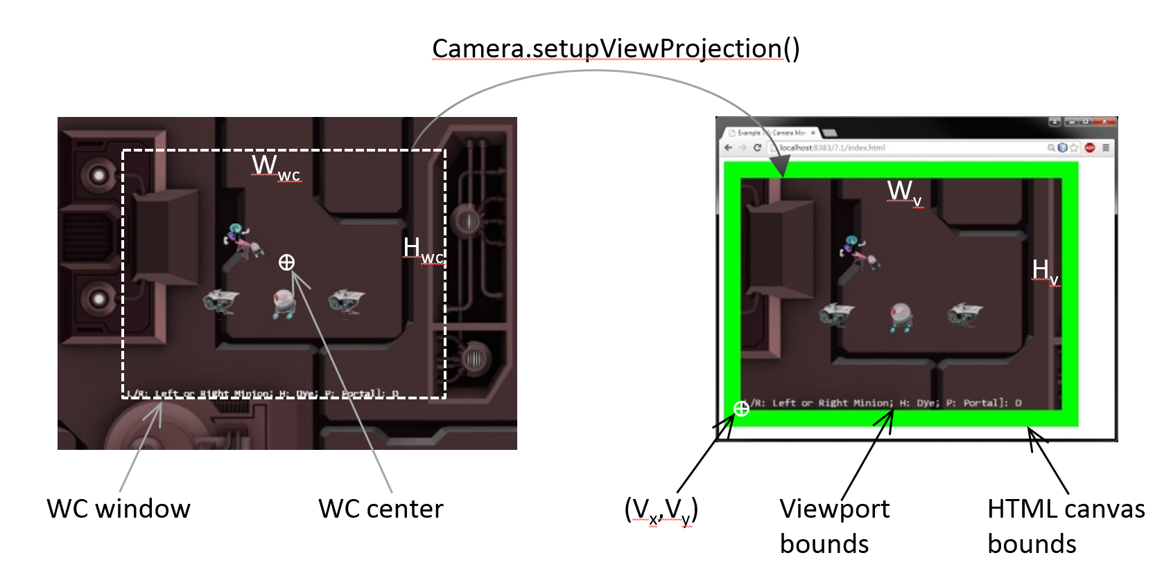
Review
Encoded in ViewProjection matrix

Slide 4
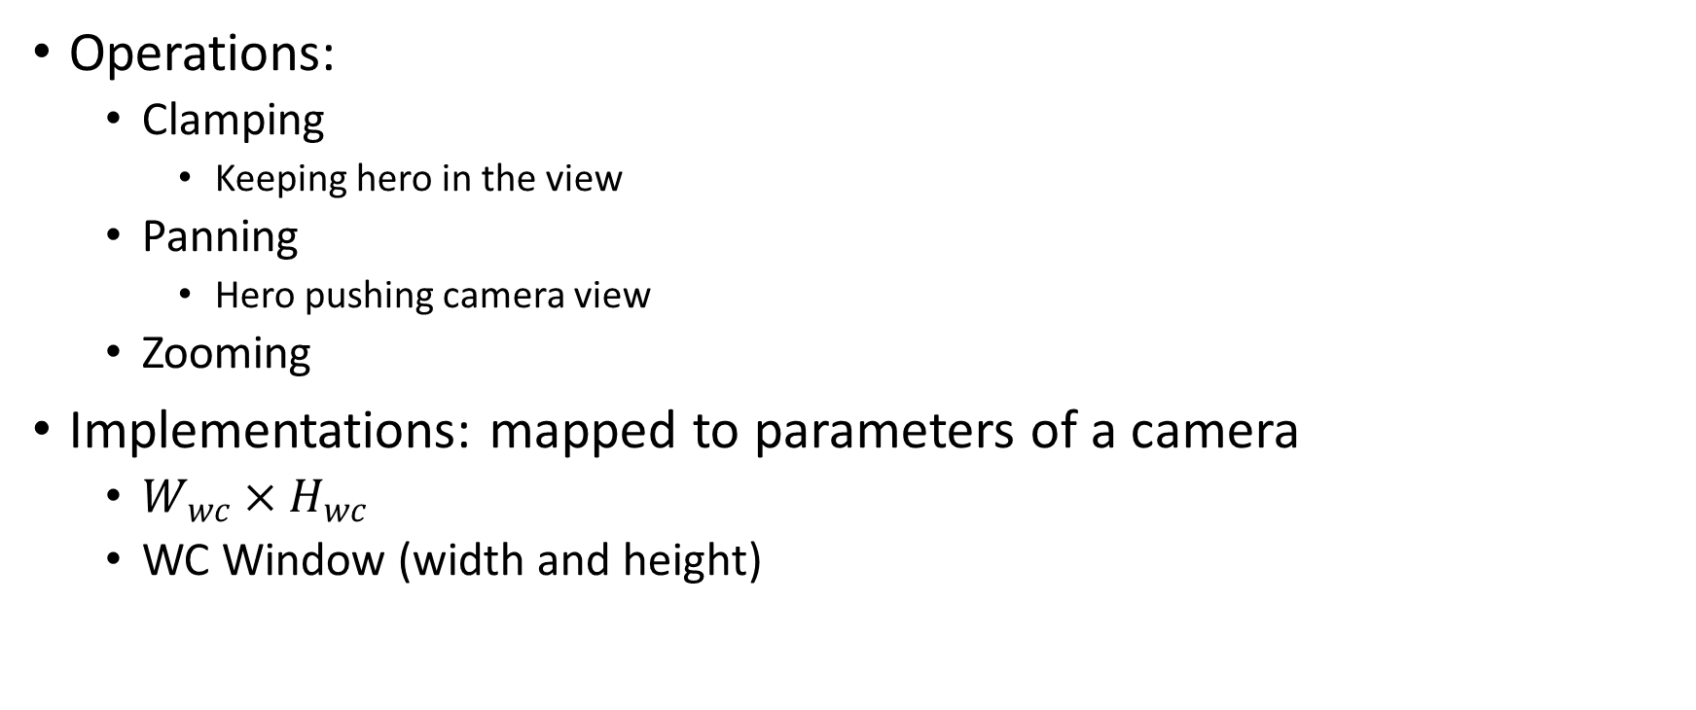
Camera Manipulations
Operations:
Clamping
Keeping hero in the view
Panning
Hero pushing camera view
Zooming
Implementations: mapped to parameters of a camera
$W_{wc}×H_{wc}$
WC Window (width and height)

Slide 5
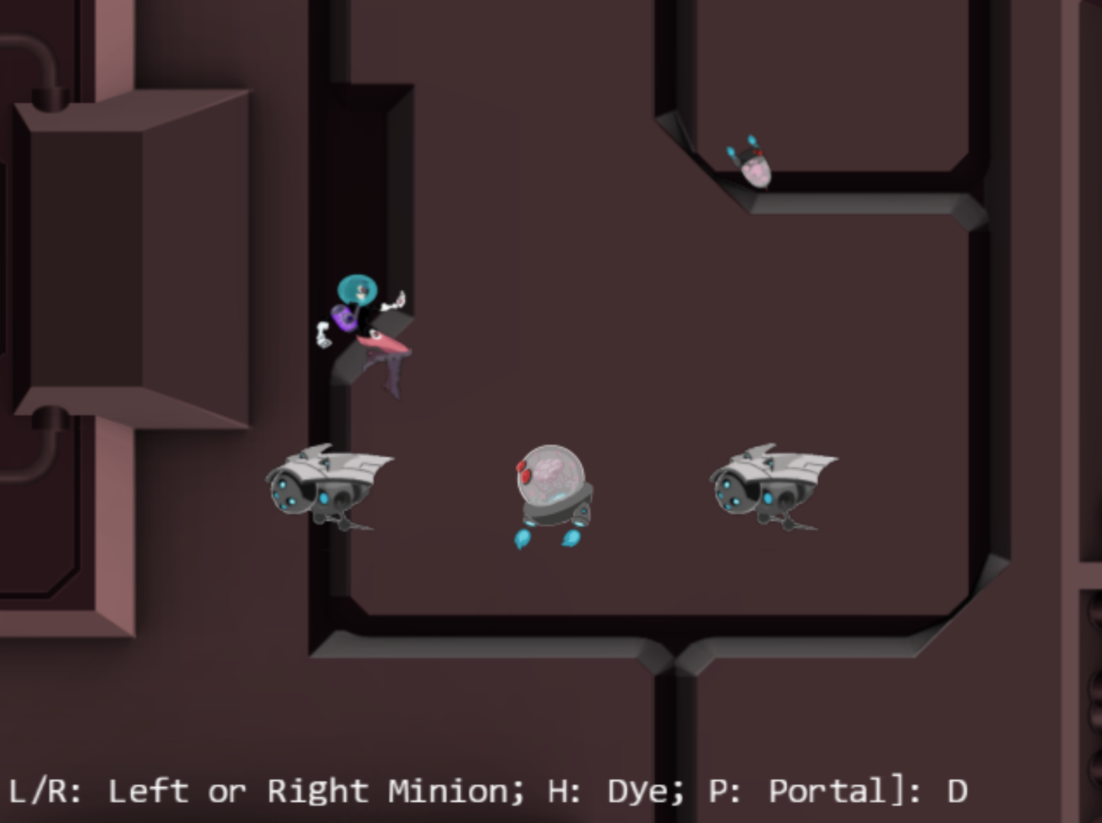
7.1: Camera Manipulations Project

Slide 6
7.1: Goals
Experience common camera manipulation operations
Understand the mapping from manipulation operations to camera parameters
Implement the manipulation operations

Slide 7
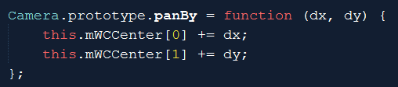

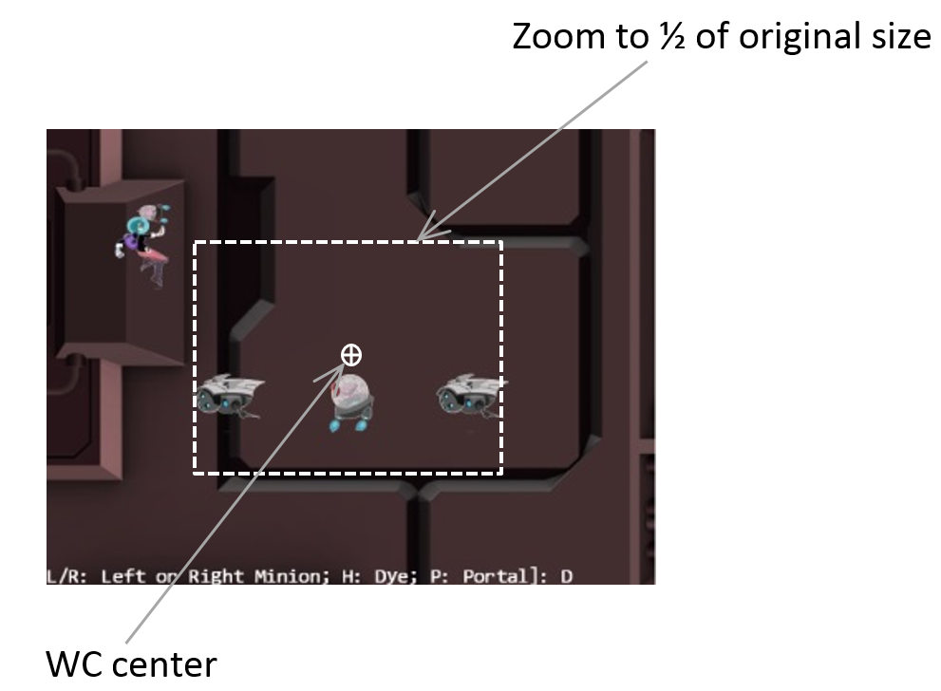
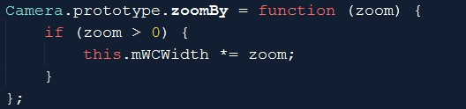
Camera_Manipulation.js: operations
Translate WC window
Zoom with respect to center

Slide 8
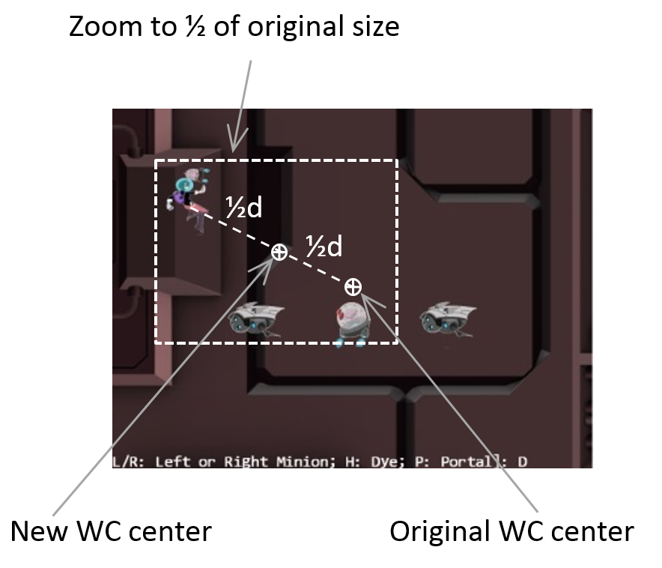
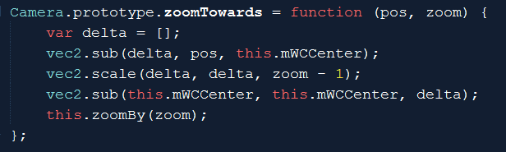
Zoom towards a fix location
Zoom wrt pos (Dye)
Delta: from wcCenter towards pos
If zoom > 1
wcCenter moves away from pos (see more world)
If zoom < 1
wcCenter moves towards pos (see less world)
After moved wcCenter, change wcWidth as usual
delta: from wcCenter towards pos

Slide 9
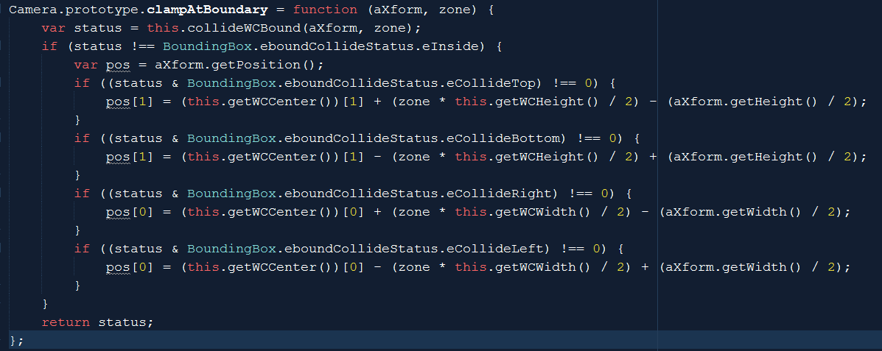
Clamp Obj (xform) to Camera WC Bounds

Slide 10
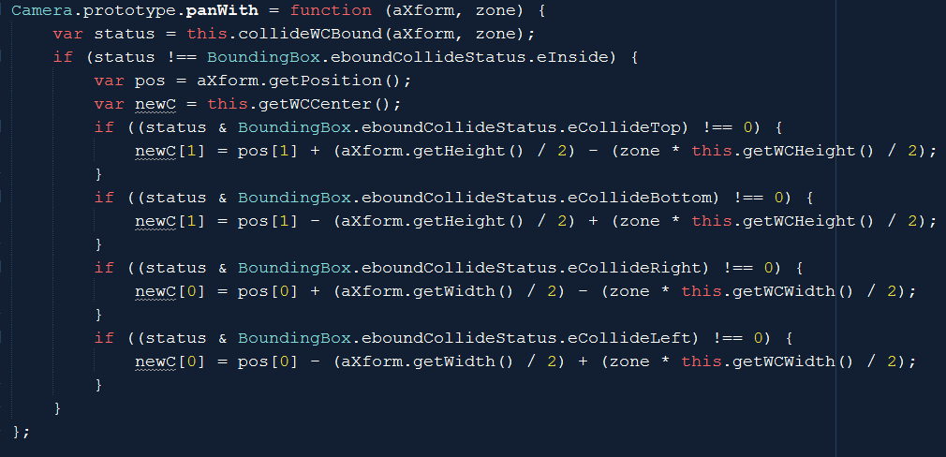
Opposite of clamp: Pan Camera with Obj
Camera_Manipulation.js

Slide 11
Testing:
WASD: move hero to pan camera (90%)
Arrow: move portal clamped (80%)
L/R: Camera pan to Left/Right
N/M: Zoom wrt center
L/R/P/H: Select Left/Right/Portal/Hero
J/K: zoom wrt to selected position
Put finger over selected object and zoom
Object does not change relative position

Slide 12
Powerful functionality, bad user experience
Sudden changes resulting from manipulation (e.g., panTo())
May seem incoherent (whole world jumped)
Gradual changes (in real life) would be nice

Slide 13
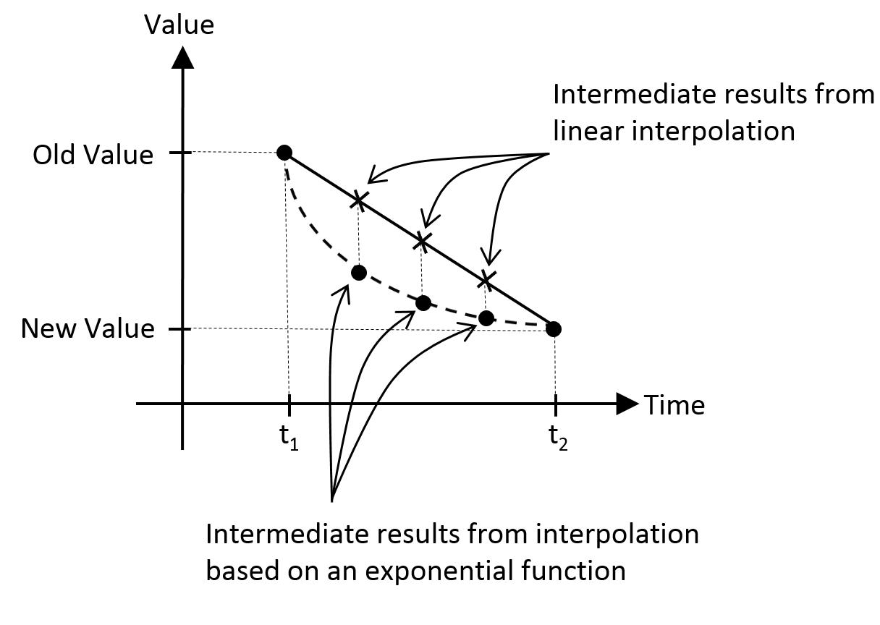
Need for interpolation
Gradual change of values: over time in this case
Example: two types of interpolations
Linear: change with fix rate
Exponential: change based on ratio of current value (our turn towards function)

Slide 14
7.2: Camera Interpolation Project

Slide 15
7.2: Goals
Understand and work with interpolated results
Implement interpolation to support gradual camera parameter changes
Understand keys to implementing interpolation
Keeping track of and separating: current from final values
Support access to current values
Need update() to trigger interpolation computation to take current value closer to final value

Slide 16
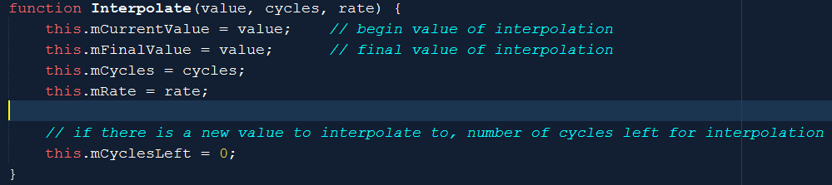
Interpolate.js: A Utility
From: mCurrentValue, Change to: mFinalValue
In: mCycles, changes at mRate
mCyclesLeft: keeps track of how many left

Slide 17
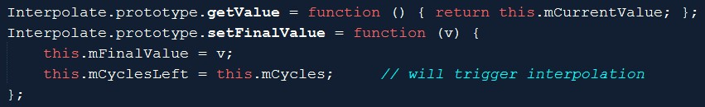

Interpolate.js: get/set/configure
Get current interpolated result
setFinalValue() triggers new interpolation
Stiffness: how quickly values change
Duration: how long to change from initial to final

Slide 18
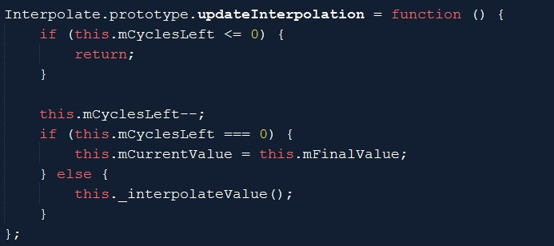
Interpolate.js: compute intermediate value
If cycles left
compute
Each iteration: linearly changing from current to final
Overall: exponential function from initial to final

Slide 19
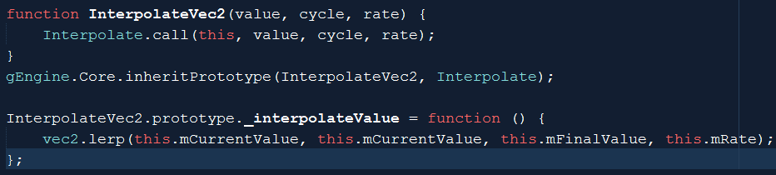
InterpolateVec2.js
Need to interpolate vec2 objects!
Vec2.lerp() implements the same interpolate._interpolateValue()
For each of the x/y components

Slide 20
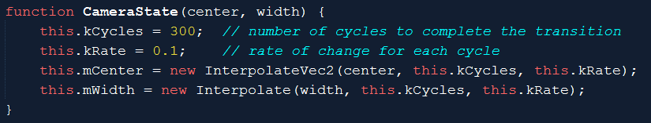
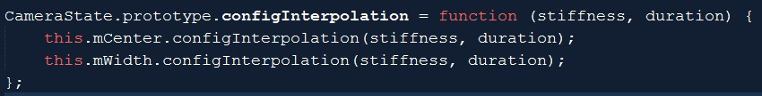
CameraState.js: current and final values
Notice the references to: Interpolate and InterpolateVec2
Configuration:

Slide 21
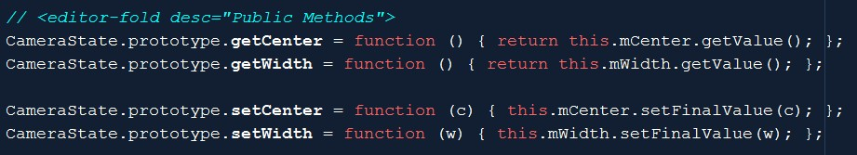
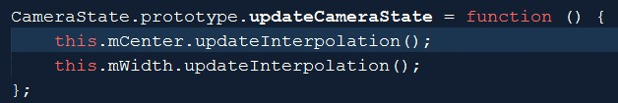
CameraState.js: set/get, trigger interpolation
Get current values
Set: sets final value for interpolation
Triggers actual interpolation

Slide 22
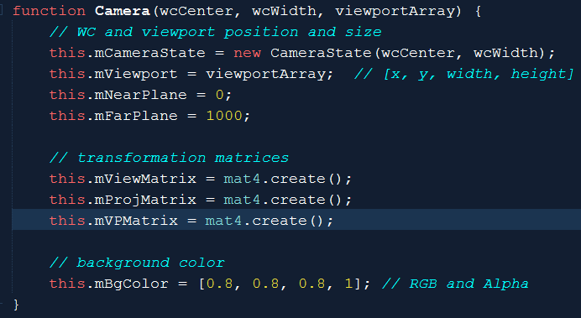
Integrate CameraState
Camera only reference to CameraState
All set/get to wcCenter and wcWidth now refers to CameraState

Slide 23

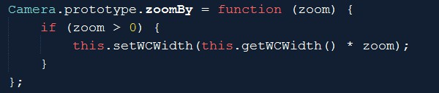
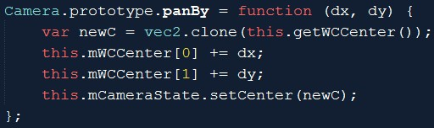
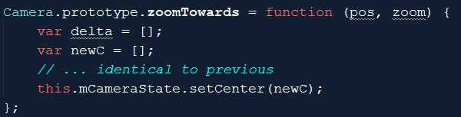
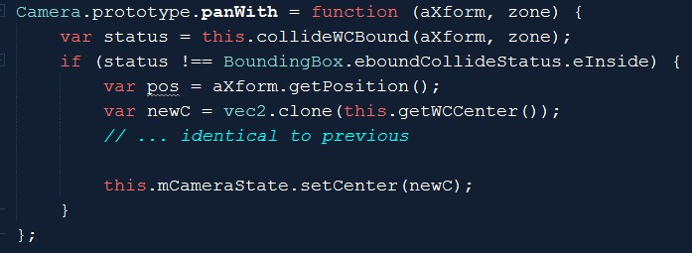
Camera manipulation: to CameraState

Slide 24


Camera_Manipulate: update + config

Slide 25
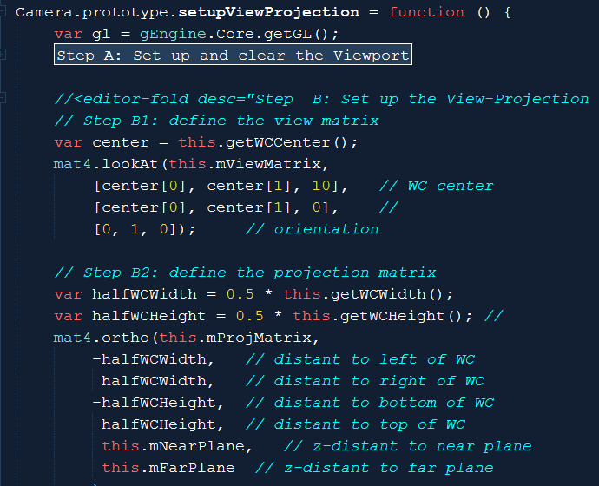
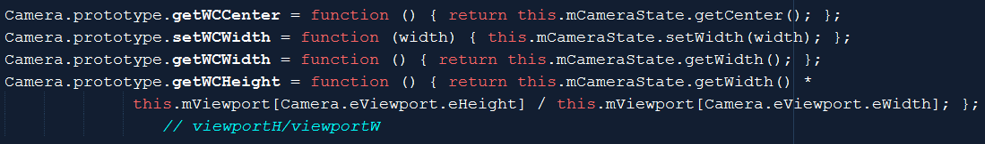
Use CameraState when compute VPMatrix

Slide 26
Testing interpolated manipulation
Notice the much smoother transitions
MyGame.update() → calls camera.update()!!
Stiffness:
Large values (e.g., 0.8, or 0.9):
degenerates to sudden changes
Very smaller values (e.g., 0.01):
Slow motion effect
Duration:
Very large values (e.g., 500)
Seems to never reach stable value (tiny movements towards the end)
Very small values (e.g., 10)
Unable to complete the function smoothly
Degenerates to sudden jumps at the end

Slide 27
Shaking the camera
Interesting way to convey “SOMETHING IMPORTANT” has occurred
Boss appear/defeated
Large object collision
Parallel goal: examine another example of controlling with math
Reflection of real-life example
Aiming the camera and knocked off the target
Retargeting: Return “quickly”, and adjust to stop at target

Slide 28
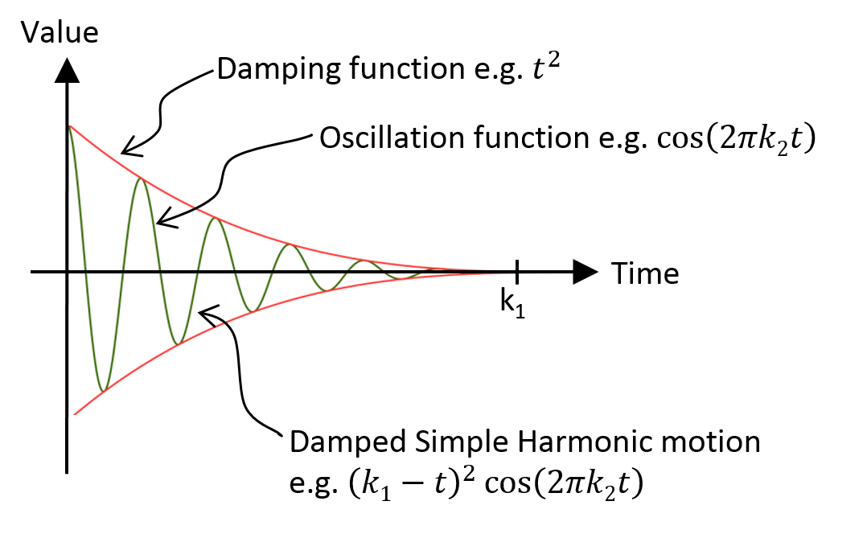
Damped Harmonic Motion

Slide 29
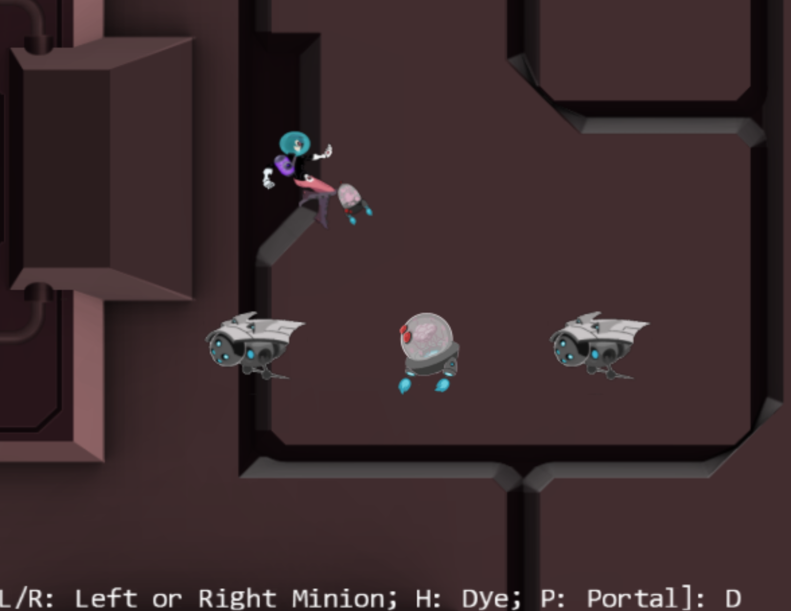
7.3: Camera Shake Project

Slide 30
7.3: Goals
Additional insights into modeling displacements with simple mathematical functions
Experience with the camera shake effect
Implement camera shake as a pseudorandom damped simple harmonic motion

Slide 31
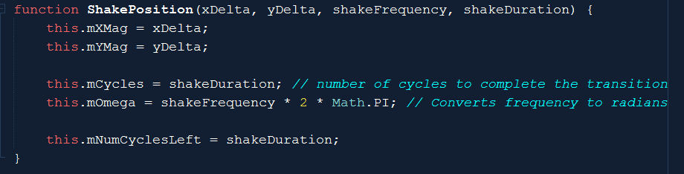
ShakePosition.js (Utility)
mXMag/mYMag: initial displacement
mCycles: how long to settle back
mOmega: how much “back-and-forth”

Slide 32
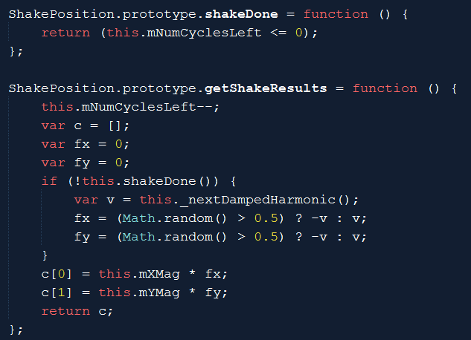
Update shake position

Slide 33
Update shake position
Why?: to avoid perfect oscillation!
Try just returning the v value (without the sign flipping)!! (e.g., Large amplitude (10, 10), frequency of 5, over 600 cycles) [5 complete oscillation in 10 seconds)

Slide 34
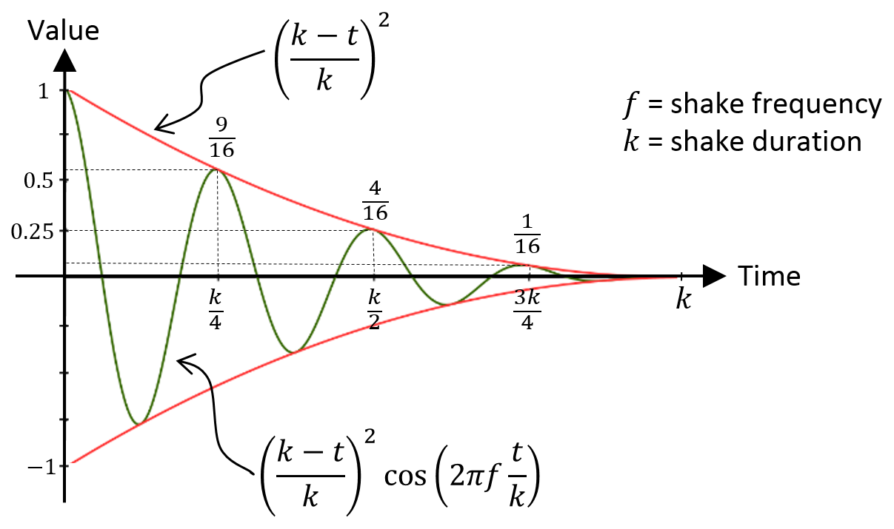
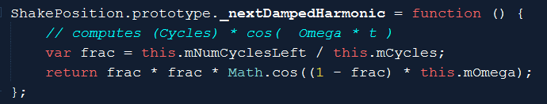
Damp Harmonic
fact:
between 0 to 1
fact*fact:
To decrease the sinusoidal more rapidly than a line
Result is a displacement!

Slide 35
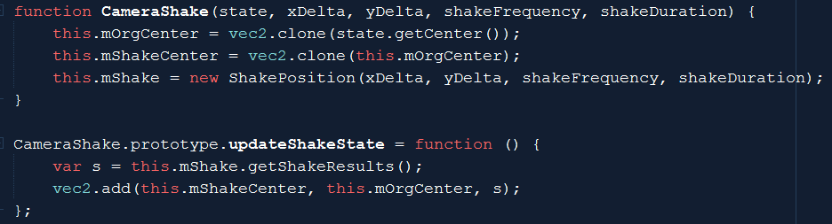
CameraShake.js: Integrate shake into
Shaking the CameraState’s center
Change the center by ShapePosition’s displacement (s)
Adding the offset to the origin (without changing the origin)
Offset becomes smaller over time

Slide 36
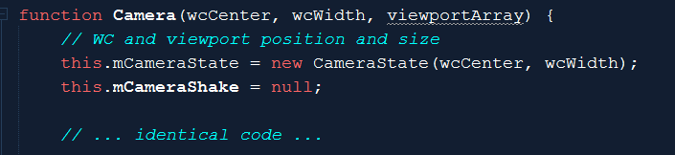
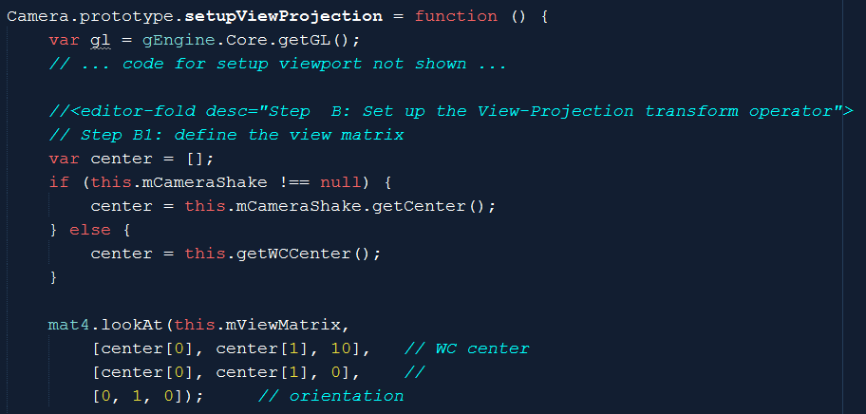
Modify the Camera

Slide 37
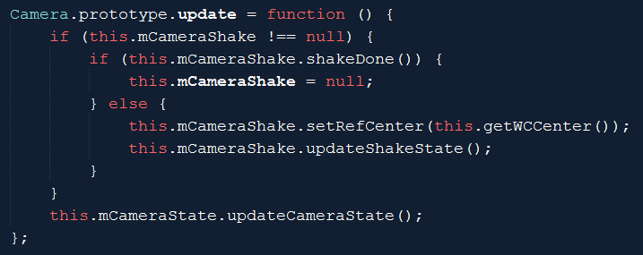
Set and update Shake (Camera_Manipulation)

Slide 38

Testing camera shake
xyDelta:
Large (200): earth quake! Small (0.1): can’t see anything!
Frequency:
Only observable with large xyDelta, larger values tend to “softens” the shake
Duration:
Large duration (300): annoying? Short duration (3): subtle, seem like error!
WATCH OUT!
Shake is an offset (to the original value)
Always keep/restore the original value

Slide 39
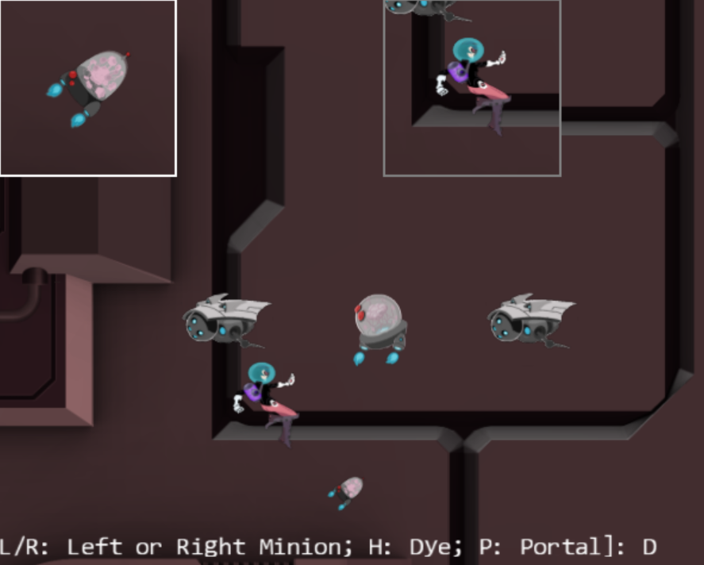
7.4: Multiple Camera and Viewport
We have done this in MPs!

Slide 40
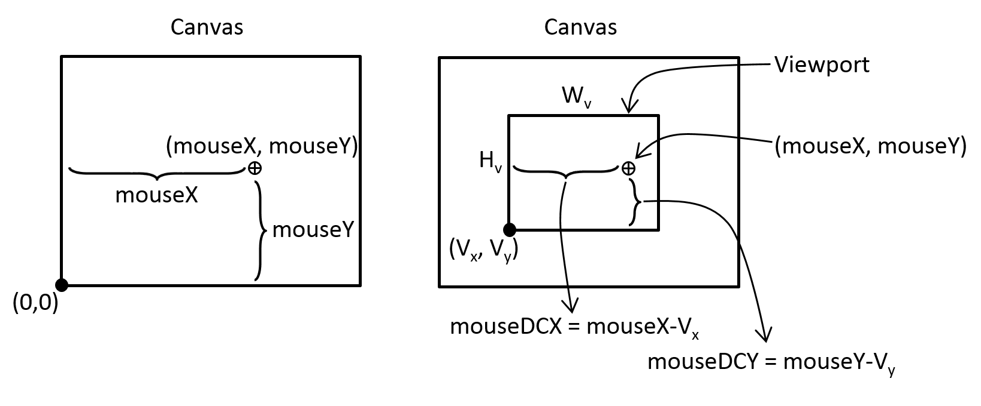
Working with Mouse Input (Selection!)
Mouse positions: Canvas coordinate!
GameObjects are in WC!
Canvas to Viewport

Slide 41
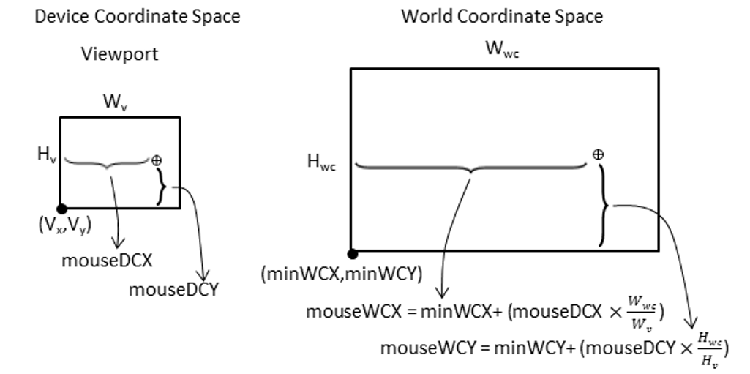
Viewport (device) to World Coordinate!

Slide 42
Questions
My canvas is 1000x800
My camera1: Center(50, 50), Width=100, Viewport:[100, 200, 400, 600]
My camera2: Center(100, 100), Width=10, Viewport: [50, 100, 100, 100]
Sketch my viewports in the canvas
HTML5 reports that a mouse click occurs at: (mouseX, mouseY)
(50, 100): should I care about this?
(300, 400): how about now?
What are the point in DCx, DCy for my two viewports?
What are the points in WCx, WCy for my two cameras?

Slide 43
Questions
My canvas is 1000x800
My camera1: Center(50, 50), Width=100, Viewport:[100, 200, 400, 600]
My camera2: Center(100, 100), Width=10, Viewport: [50, 100, 100, 100]
Sketch my viewports in the canvas

Slide 44
Questions
My camera1: Viewport:[100, 200, 400, 600]
My camera2: Viewport: [50, 100, 100, 100]
HTML5 reports mouse click occurs at: (mouseX, mouseY)
(50, 100): should I care about this?
(300, 400): how about now?

Slide 45
Questions
[100, 200, 400, 600] [50, 100, 100, 100]
(50, 100): should I care about this?
With respect to Orange: DCx = -50, DCy=-100
➔Orange does not care about this point
With respect to Red: DCx = 0, DCy= 0
➔ Red cares about this point (inside Red viewport)
(300, 400): how about now?
With respect to Orange: DCx = 200, DCy=200
➔ Orange cares about this point (in Orange viewport)
With respect to Red: X = 250, Y= 300
➔ Red does not care (outside of Red viewport)

Slide 46
Questions
Viewport: [50, 100, 100, 100]
We know … HTML reports: (50, 100)
In Red DC: DCx = 0, DCy= 0
Now for: WCx, WCy (over the Red DC)
Center(100, 100), Width=10
Lower-left = (100-10/2, 100-10/2) = (95, 95)
So, the following are the same point
Canvas-(50, 100)
DC-(0, 0)
WC-(95, 95)
10
10
(100, 100)

Slide 47
Questions
Center(50, 50), Width=100 [100, 200, 400, 600]
Canvas (300, 400): Orange: DCx = 200, DCy=200
Percent coverage in DC
X = 200 / 400 = 50%
Y = 200 / 600 = 33.33%
Amount in WC
X = 50% * Width = 50% * 100 = 50
Y = 33.3% * Height = 33.33% * 150 = 50
WC: Lower-left = (50-100/2, 50-150/2) = (0, -25)
WCx, WCy = (50, 25)
100
(50, 50)
150

Slide 48
Summary
Center(50, 50), Width=100 [100, 200, 400, 600]
Canvas (300, 400): Orange: DCx = 200, DCy=200
Percent coverage in DC
X = 200 / 400 = 50%
Y = 200 / 600 = 33.33%
Amount in WC
X = 50% * Width = 50% * 100 = 50
Y = 33.3% * Height = 33.33% * 150 = 50
WC: Lower-left = (50-100/2, 50-150/2) = (0, -25)
WCx, WCy = (50, 25)
DCx = mouseX – ViewportOrgX
WCx = LLx + WC-Width * DCx / ViewportWidth
LLx = lower-left-x = Camera-X – (WC-Width / 2)

Slide 49
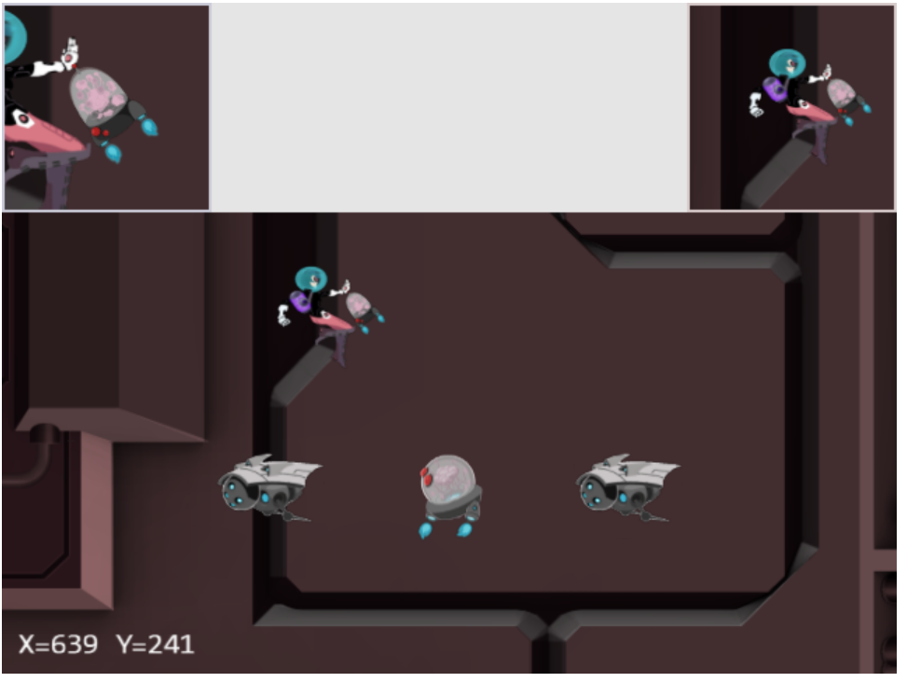
7.5: Mouse Input Project
LMB in main view:
Drags the Portal object
MMB the HeroCam view:
Drags the Hero object
RMB or MMB in any view:
Hides/shows the Portal

Slide 50
7.5: Goals
To understand the Canvas Coordinate space to WC space transform
To appreciate mouse clicks are specific to individual viewports
To implement transformation between coordinate spaces and support mouse input

Slide 51
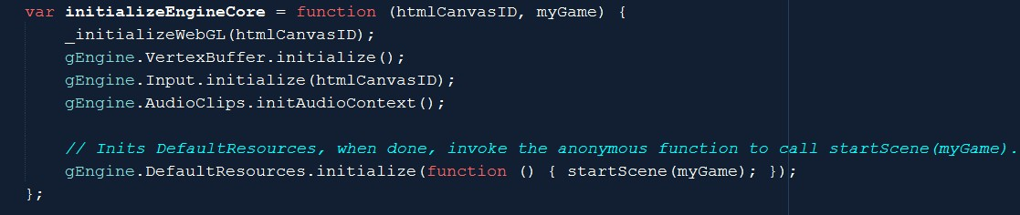
Implementation: Input needs access to canvas
Engine_Core.js

Slide 52
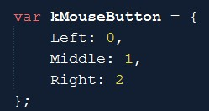
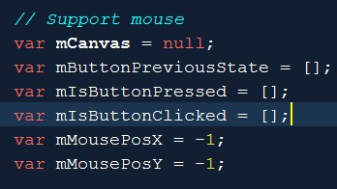
Engine_Input.js
Arrays: to support left/mid/right
Press/Click (just like keyboard)
mMousePosX/Y
In canvas coordinate

Slide 53
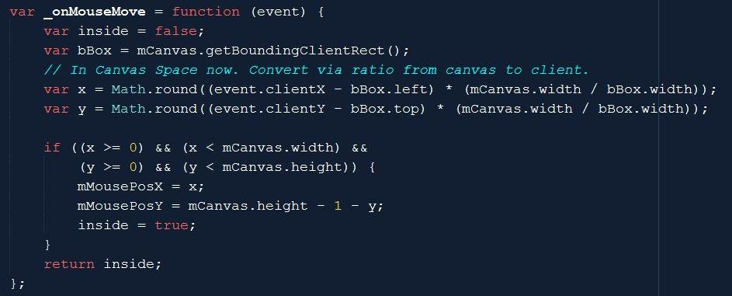
Engine_Input:: event handlers
Transform from web-page to canvas

Slide 54
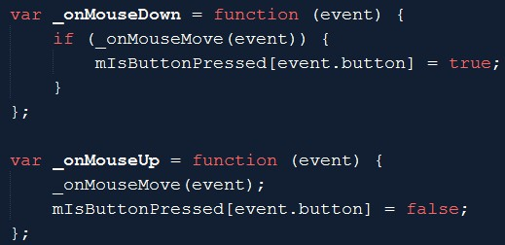
Engine_Input:: mouse clicks
event.button: 0, 1, or 2

Slide 55
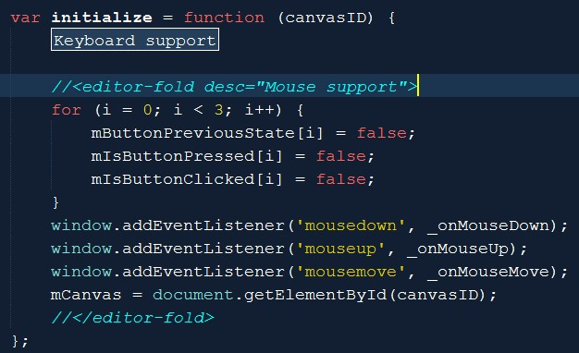
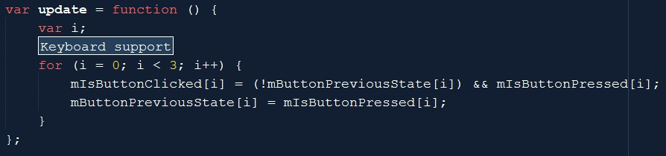
Engine_Input: init and update

Slide 56
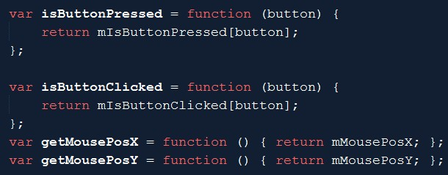
Engine_Input:: query
mousPos X/Y: in canvas coordinate
Must transform to WC before can be used for selection!!
DC is Viewport coordinate

Slide 57
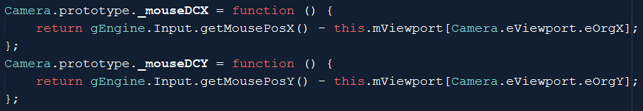

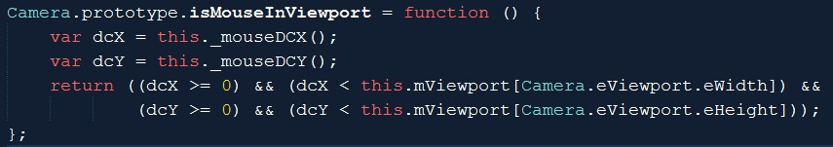
Camera_Input.js: Canvas to DC
DC is Viewport’s coordinate
If mouse click is in the viewport of a camera

Slide 58


Camera_Input.js:: DC to WC

Slide 59

MyGame.update(): Testing Mouse Input
Examine dcXY:
Test button clicks:

Slide 60


MyGame.update(): Testing Mouse Input
Test WC coordinate value and Button pressed (draggin)
Note: isMouseInViewport() function call!

Slide 61
Mouse input: notice
Can differentiate mouse click by viewport (camera)
The actual interaction code should be hidden from MyGame
Define a MyCamera to subclass from Camera
Implement mouse events in MyCamera.update()
Right-mouse-click
Browser hijacked this event!

Slide 62
Chapter 7: Learned
Camera manipulation:
Manipulation of wcCenter, wcWidth
Either change GameObject, or change camera values
Math operation/expression
For controlling smoothness
For controlling movement
Positional input device (mouse)
Ability to support multiple views
Coordinates:
Canvas, Viewport (DC), World
Image (pixels), UV (texture),
NDC

Slide 63

7.6: You can draw lines! ☺

